Slide 1
Part Consolidation Candidate Detection for Additive Manufacturing
This is the template

Slide 2
Part Consolidation Candidate Detection for Additive Manufacturing
This is the template

Slide 3
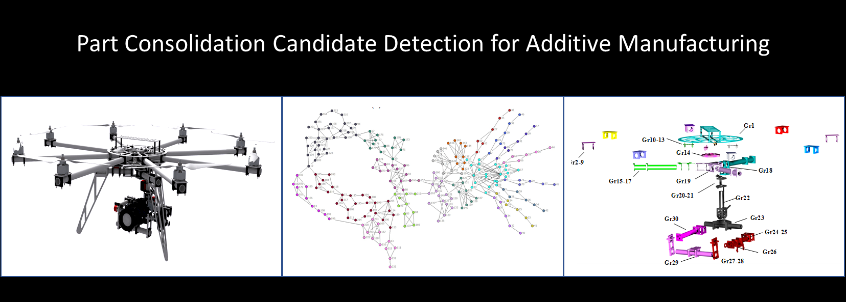

Slide 4
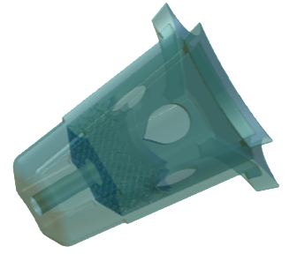
Part Fusion with Additive Manufacturing
7 parts in 1
25% weight savings

Slide 5
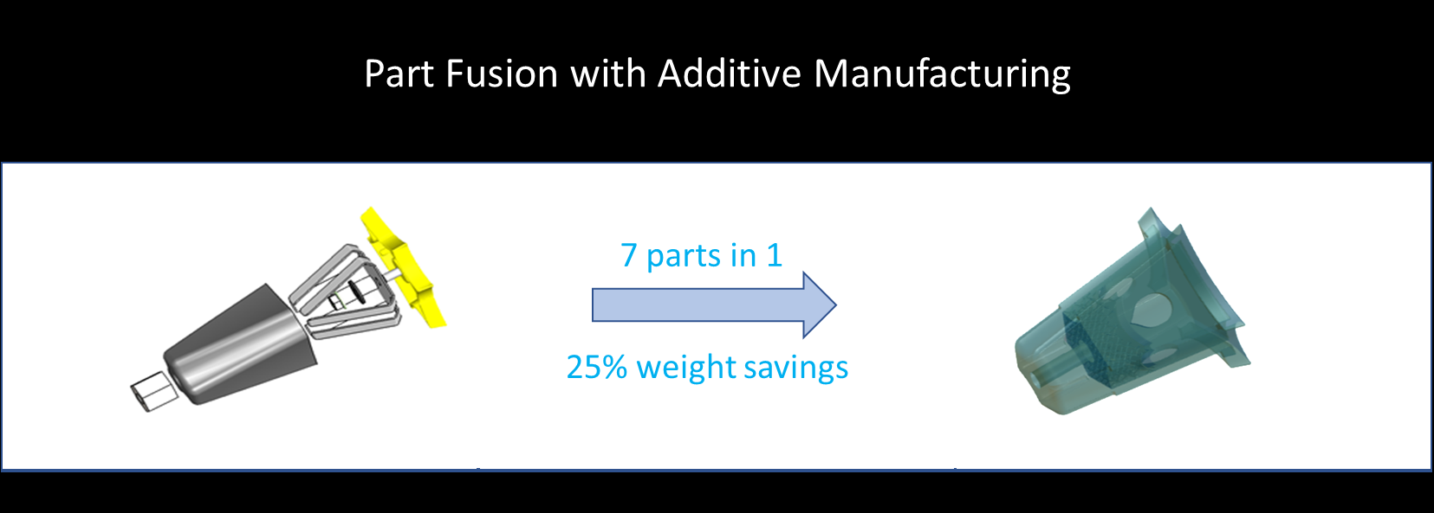

Slide 6
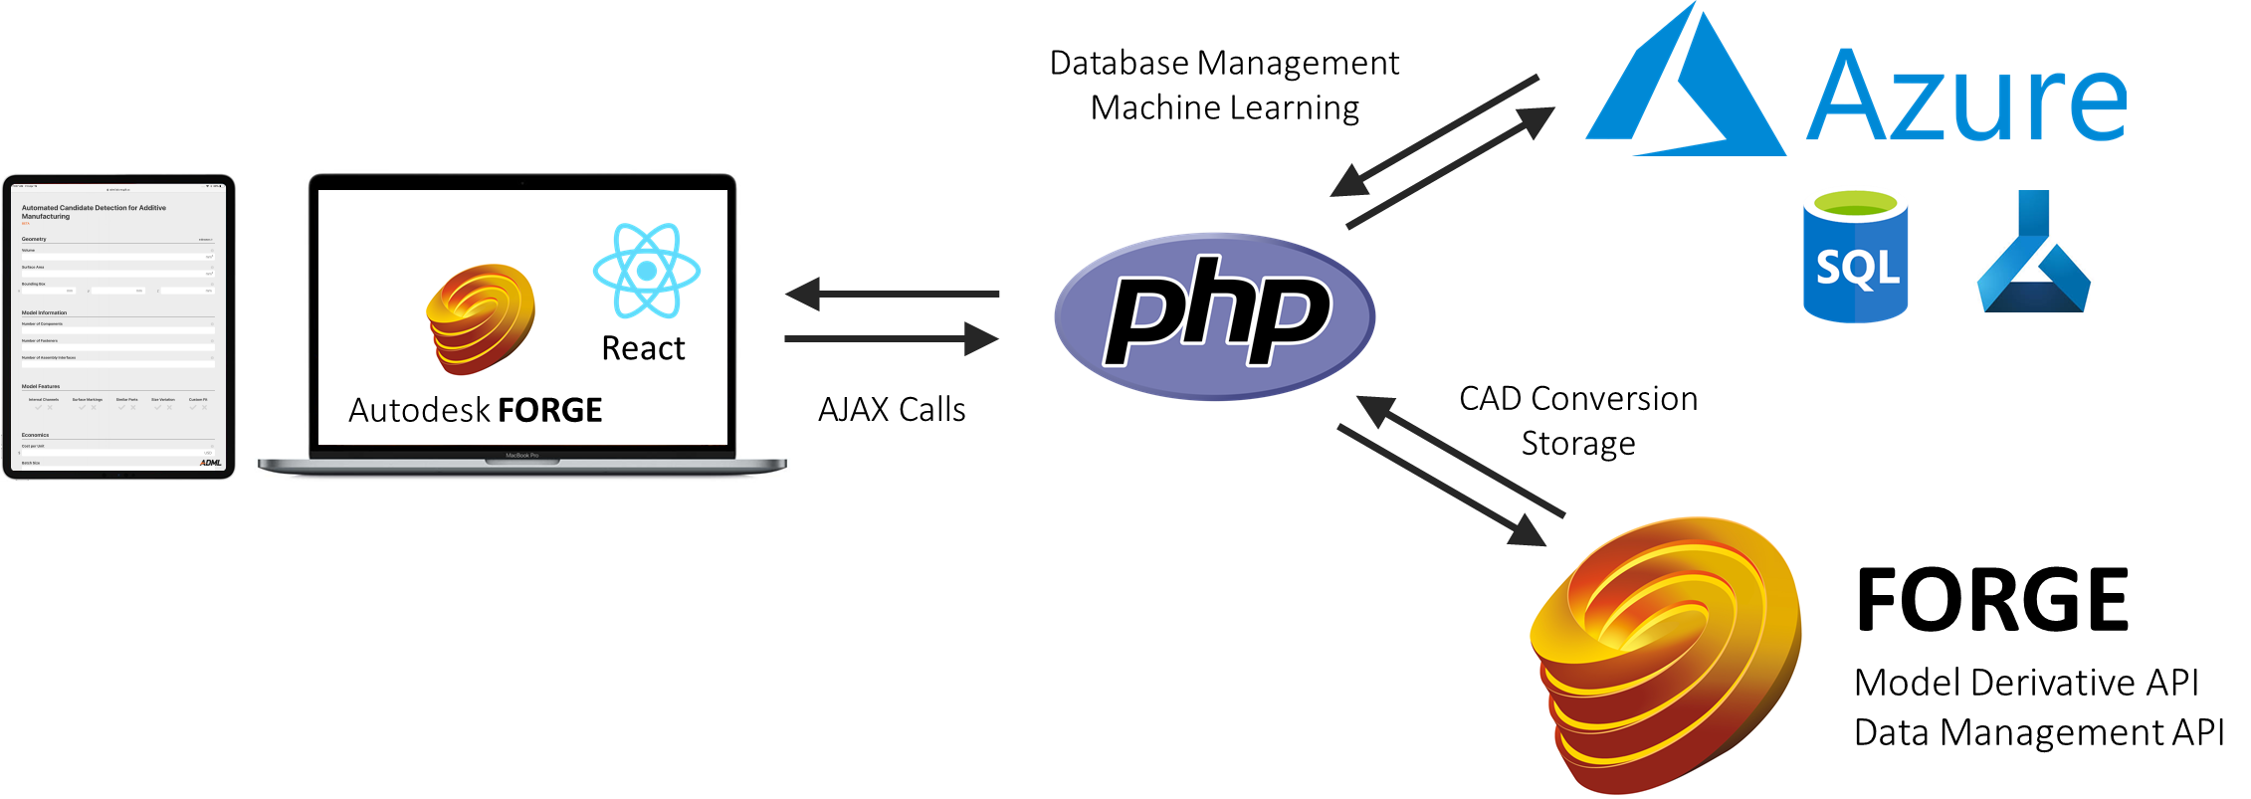
Architecture for Automated AM Candidacy Detection

Slide 7
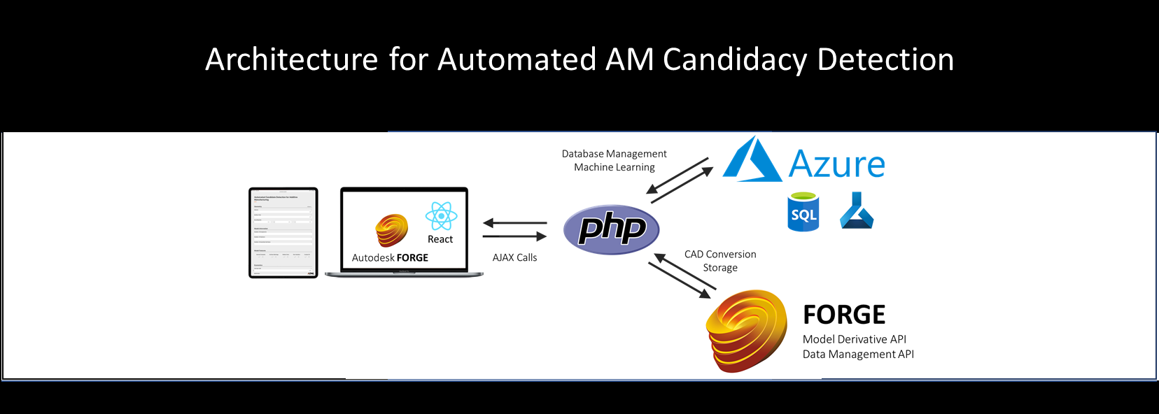

Slide 8
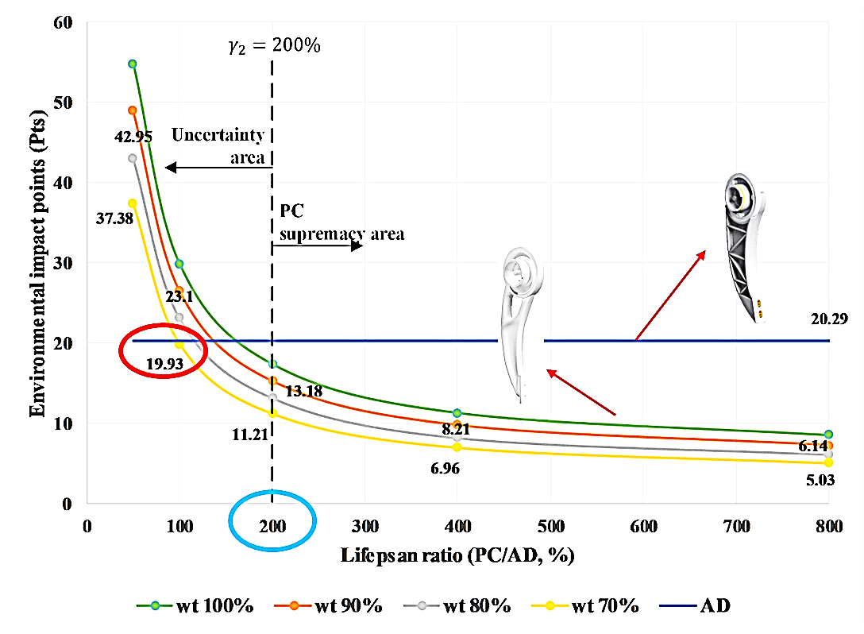
Sustainable Additive Manufacturing with Part Consolidation

Slide 9
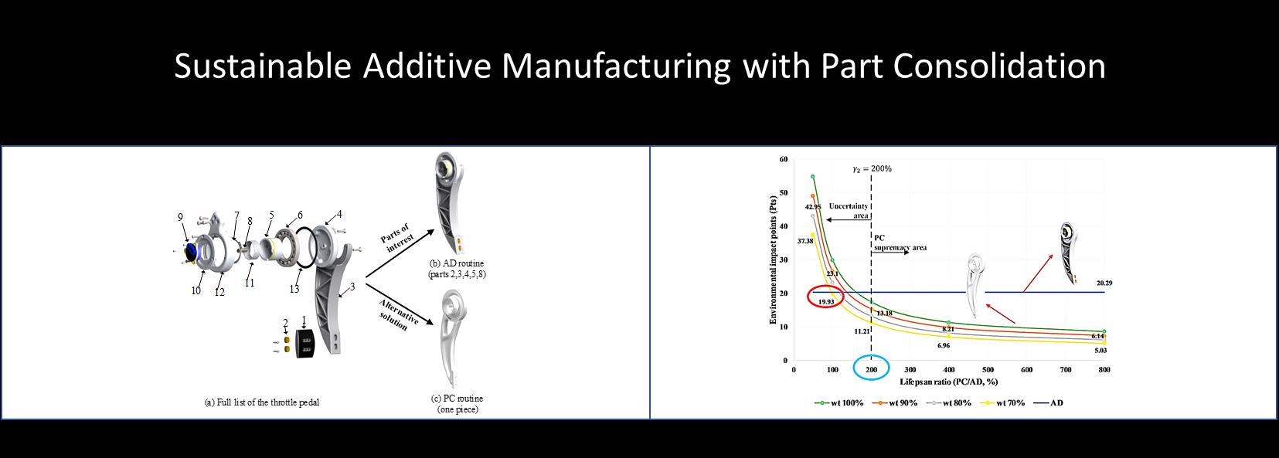

Slide 10
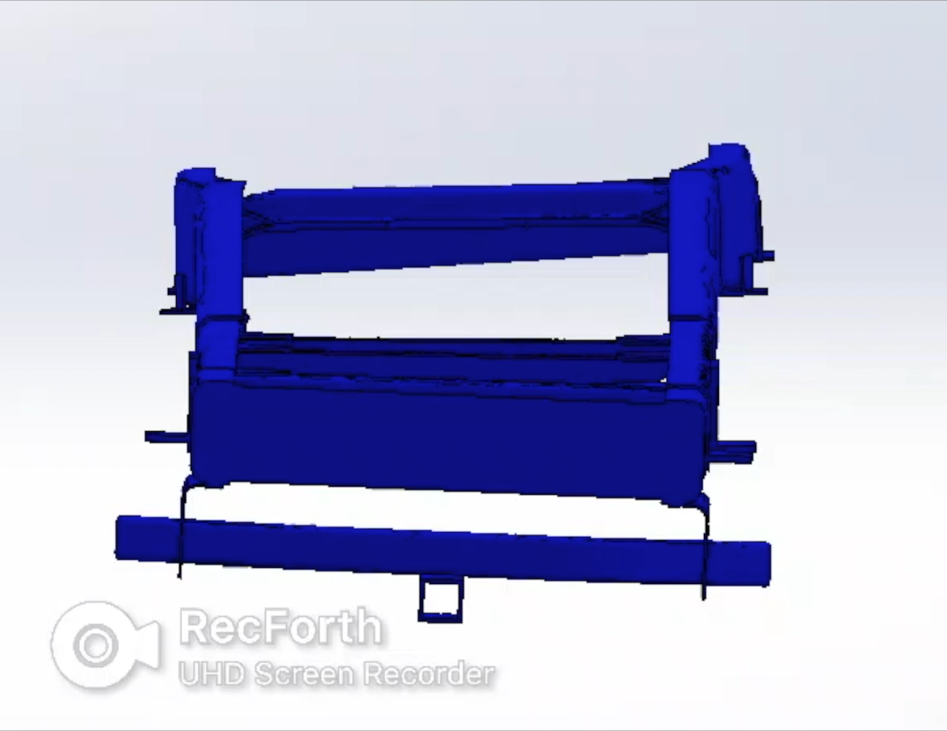
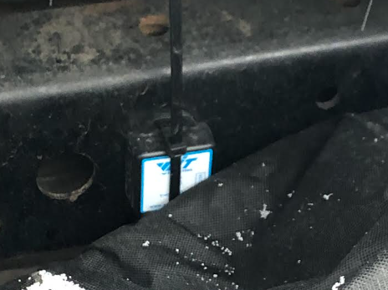
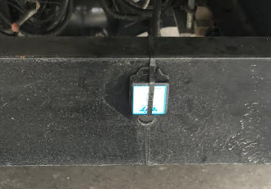
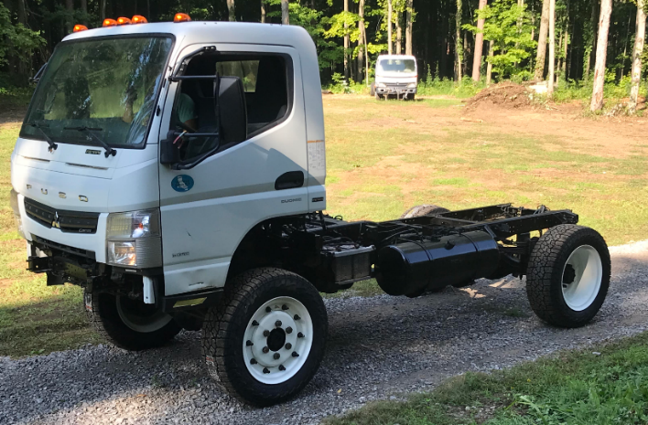
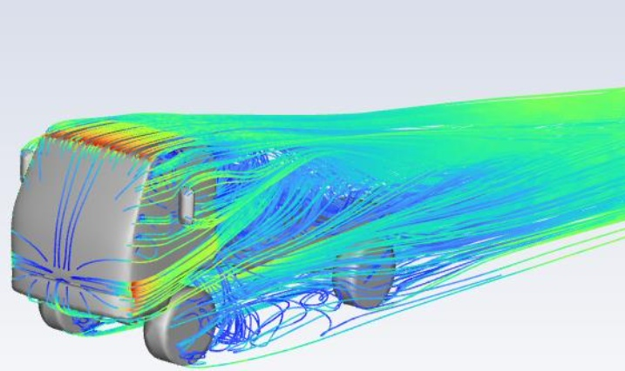
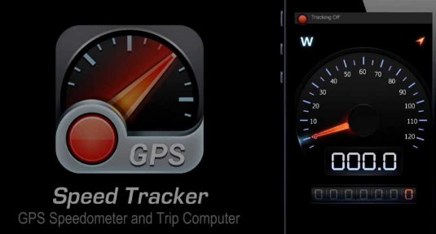
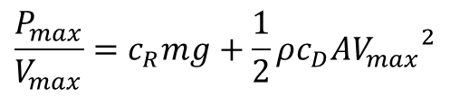
Supersystem Digital Twin for Conceptual Design
Accelerometer/ Inclinometer
Frame deflection
Realtime data
Simulation
Max G force
Max speed
GPS

Slide 11
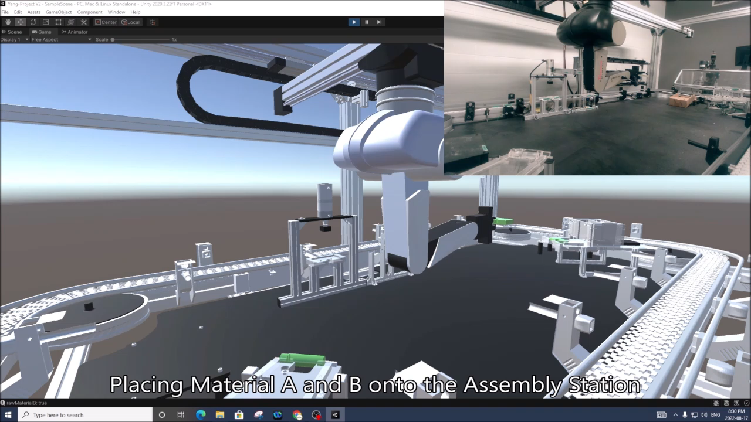
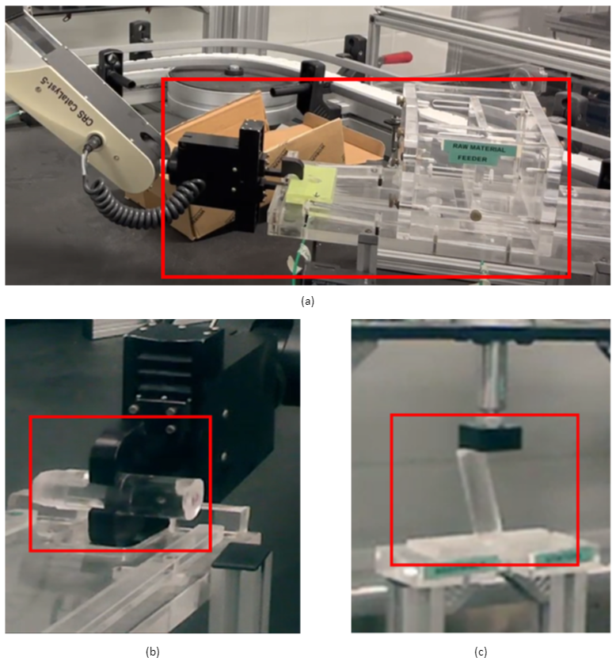
Cloud-based Digital Twin System and Consistency Check
Virtual State
Syn
Asyn
Ideal Physical State
Real Physical State
Cloud-based Digital Twin
Delay
Virtual-Real Inconsistency check

Slide 12
